Slide 1
Workflow of TCP in NS3
Congestion Control Perspective
Subsection: B2
Group: 6-2
Student IDs:
1705091
1705103
1705119

Slide 2
Evolution of TCP Vegas from TCP Tahoe
TCP Tahoe:
congestion window (cwnd) increases exponentially in slow start phase
cwnd increases linearly in congestion avoidance phase
TCP Reno:
Fast Recovery and Fast Retransmit. Use of 3 duplicate ACKs to detect congestion
cwnd falls to half instead of 1
TCP NewReno:
cwnd inflation during Fast Recovery
Fast Recovery phase ends when all segments that might have been lost are ACKed
TCP Vegas:
Use packet delay to determine transmission rate in congestion avoidance phase
In this presentation we will see how all these concepts are implemented in NS3

Slide 3
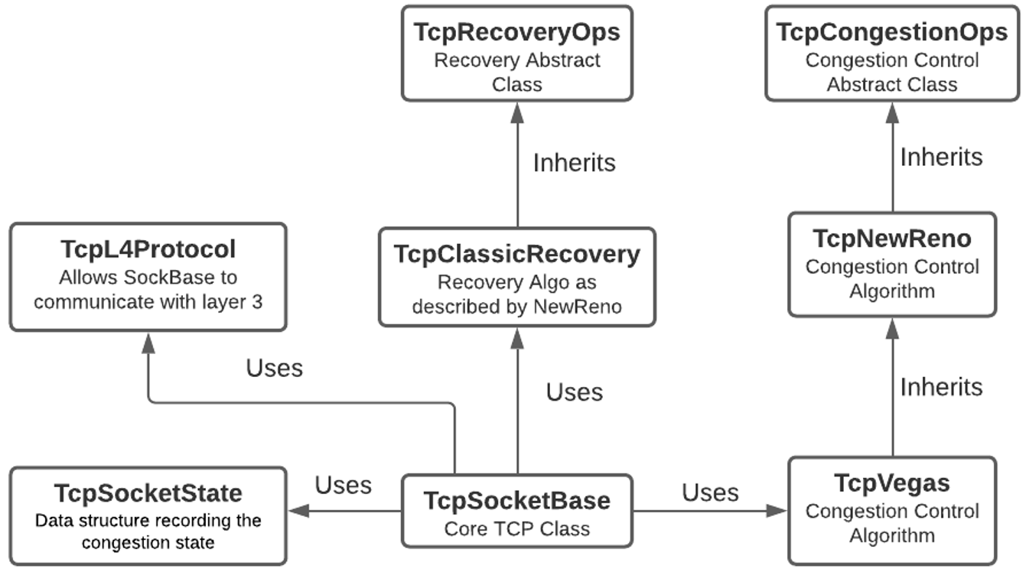
Class Diagram of Relevant Classes

Slide 4
TCP Socket State Implementation

Slide 5
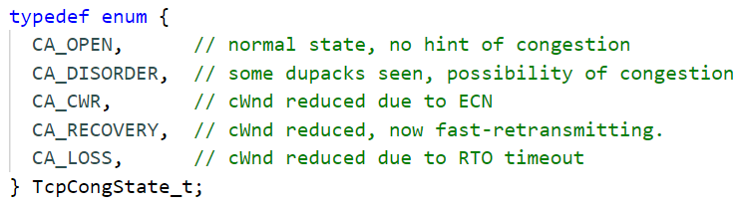
TCP Socket State - Important Attributes

Slide 6
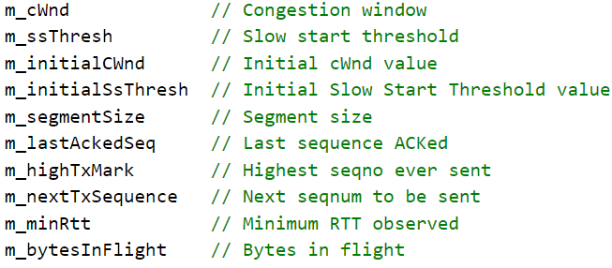
TCP Socket State - Important Attributes

Slide 7
TCP Socket Base Implementation

Slide 8
TCP Socket Base - Initialization and Default Values
TcpL4Protocol :: CreateSocket function creates an object of TCP Socket Base class
Following functions determine the default attribute values of SocketBase:
TcpSocketBase :: GetTypeId
TcpL4Protocol :: GetTypeId

Slide 9
TCP Socket Base - Initialization and Default Values
We can override the default values from user code.
For example, the following two lines can be used to override the default congestion control and recovery algorithms
Config::SetDefault ("ns3::TcpL4Protocol::SocketType", StringValue ("ns3::TcpVegas"))
Config::SetDefault ("ns3::TcpL4Protocol::RecoveryType", StringValue ("ns3::TcpClassicRecovery "))

Slide 10
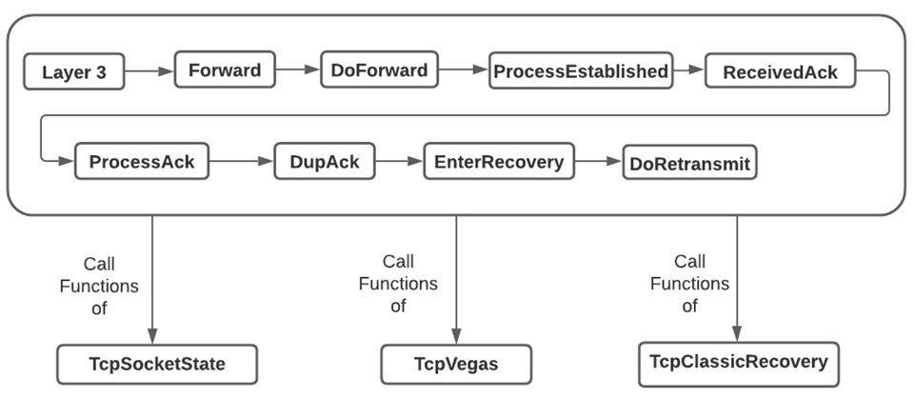
TCP Socket-Base Function Call Sequence
When ACK is received, it passes through different functions of SocketBase
Functions of SocketState, CongestionAlgo, RecoveryAlgo are called from SocketBase
This total system works together to implement Congestion Control

Slide 11
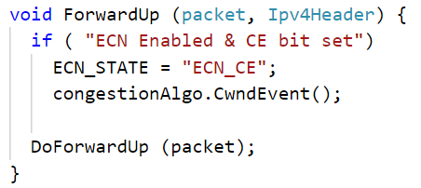
TcpSocketBase :: ForwardUp
Congestion Control Algorithms might use Explicit Congestion Notification
Congestion Control Algorithm is notified about congestion detected by ECN
Here, has receiver can detect ECN and inform sender about it.

Slide 12
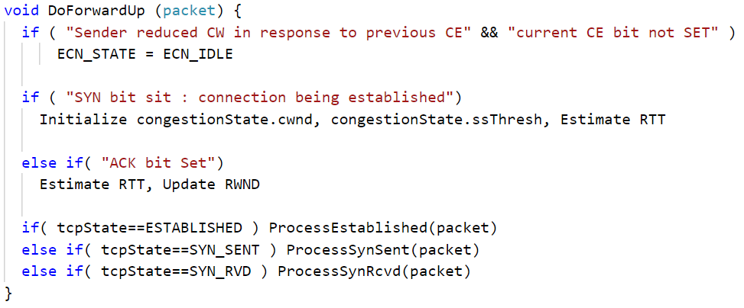
TcpSocketBase :: DoForwardUp
Take different actions depending on whether connection is being established or already established

Slide 13
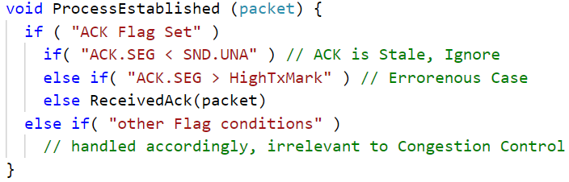
TcpSocketBase :: ProcessEstablished
ACK.SEG : Sequence Number of Acknowledgement
SND.UNA : First Unacknowledged Sequence Number in transmission buffer
HighTxMark : Highest Sequence Number ever transmitted

Slide 14
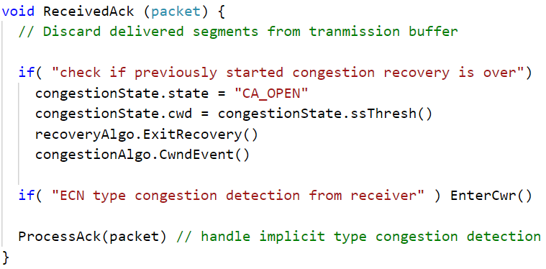
TcpSocketBase :: ReceivedAck
Congestion can be detected through Explicit or Implicit means

Slide 15
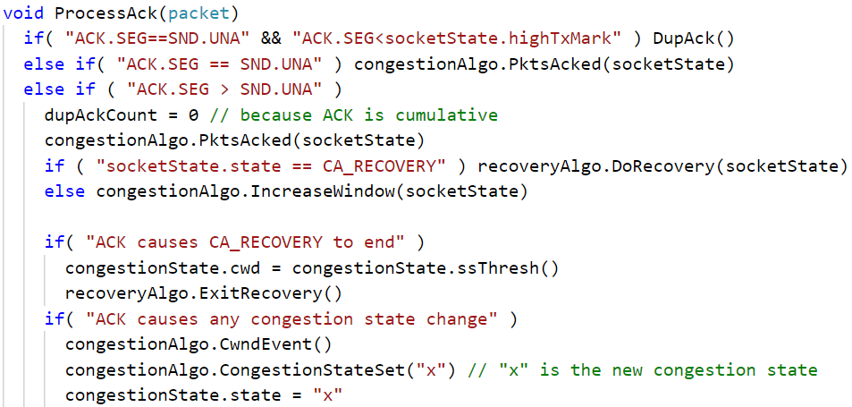
TcpSocketBase :: ProcessAck
Actual function is 297 lines! Greatly simplified here to show just relevant function calls

Slide 16
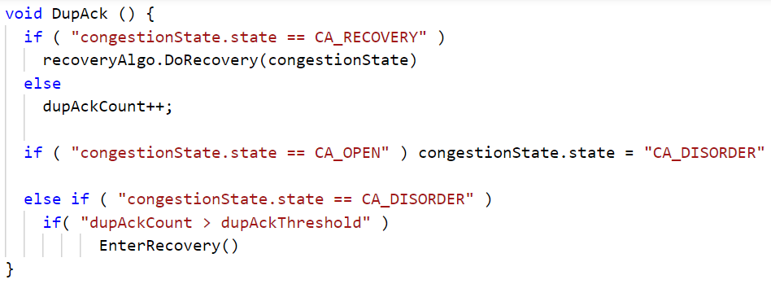
TcpSocketBase :: DupAck

Slide 17
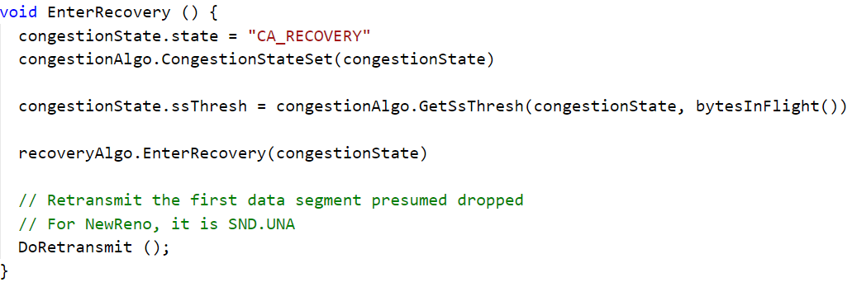
TcpSocketBase :: EnterRecovery

Slide 18
TCP Recovery Ops Implementation

Slide 19
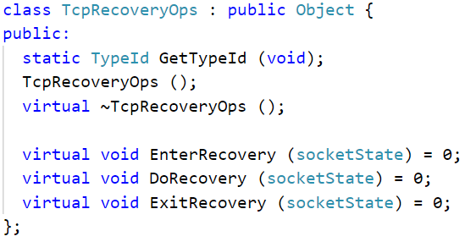
TCP Recovery Ops - Declaration
It is an abstract class
Inherited by specific recovery algorithm classes
For example:
TcpClassicRecovery
TcpPrrRecovery

Slide 20
TCP Classic Recovery Implementation

Slide 21
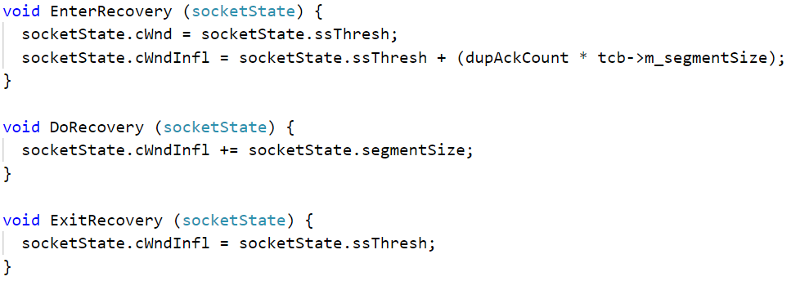
TCP Classic Recovery - Inherits TCP Recovery Ops
These 3 functions were pure virtual in TCP Recovery Ops
TCP Classic Recovery defines these functions

Slide 22
TCP Congestion Ops Implementation

Slide 23
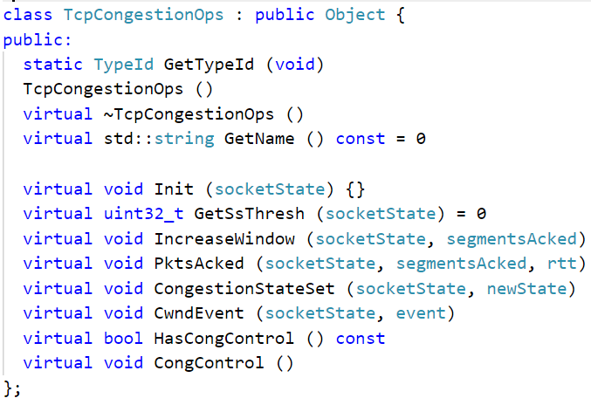
TCP Congestion Ops - Declaration
It an abstract class.
Most functions are either pure virtual or has empty definition
The various congestion control algorithms that inherit TCP Congestion Ops implement the functions as required.

Slide 24
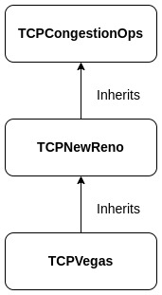
Inheritance Diagram

Slide 25
TCP Vegas Implementation

Slide 26
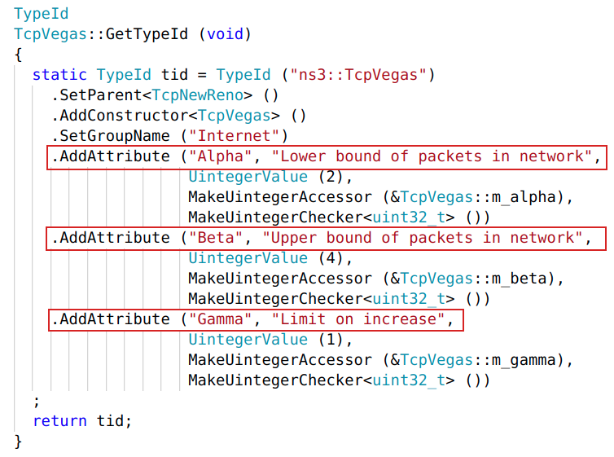
TcpVegas - Attributes

Slide 27
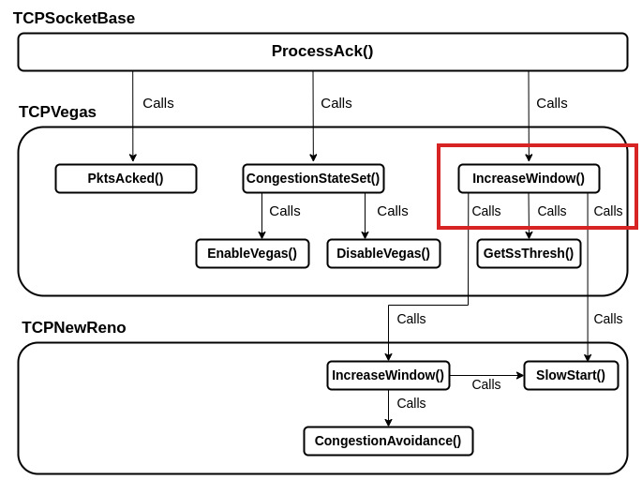
TcpVegas - Function Call Sequence

Slide 28
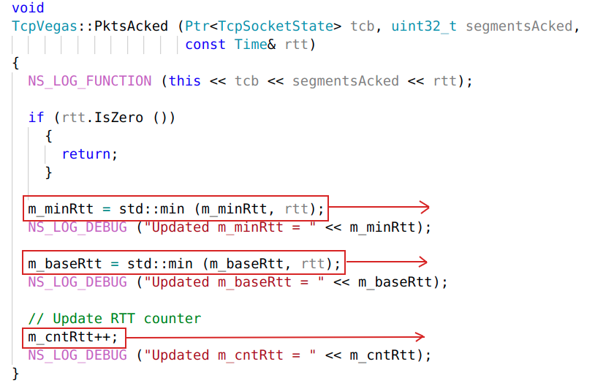
TcpVegas :: PktsAcked
called every time an ACK is received
Contains timing information
Minimum of all RTT measurements within last RTT.
Minimum of all Vegas RTT measurements seen during connection
Number of RTT measurements during last RTT

Slide 29
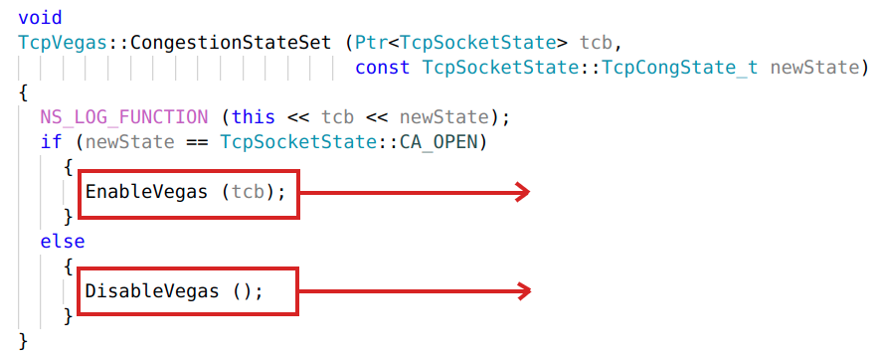
TcpVegas :: CongestionStateSet
m_doingVegasNow = true;
m_doingVegasNow = false;

Slide 30
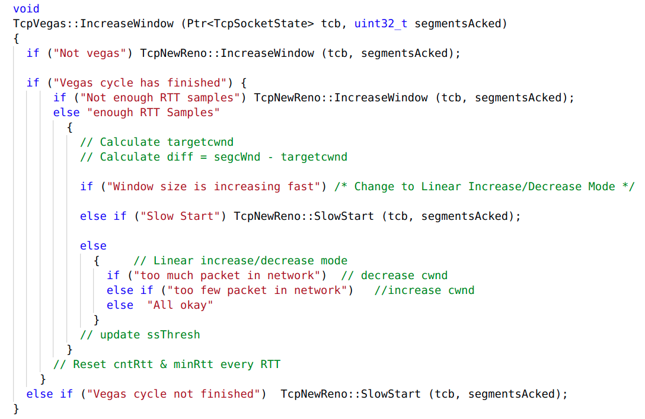
TcpVegas :: IncreaseWindow

Slide 31
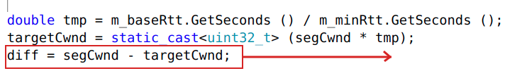
Congestion Avoidance in TCP Vegas
Implemented in IncreaseWindow()
diff Calculation
continuously samples the RTT and computes the actual throughput and compares it with the expected throughput
Amount of extra packet queued at the bottleneck

Slide 32
Congestion Avoidance in TCP Vegas
Implemented in IncreaseWindow()
Three Conditions:
Potential Congestion
No Congestion
Linear Increase/Decrease
diff > Gamma and cwnd < ssThresh
diff < Gamma and cwnd < ssThreash

Slide 33
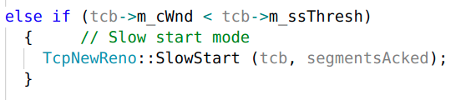
Congestion Avoidance in TCP Vegas
Implemented in IncreaseWindow()
No Congestion
-> Slow Start

Slide 34
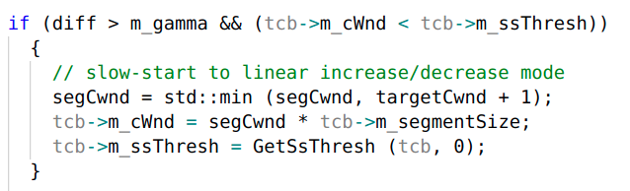
Congestion Avoidance TCP Vegas
Implemented in IncreaseWindow()
Potential Congestion
-> Increase/Decrease Mode

Slide 35
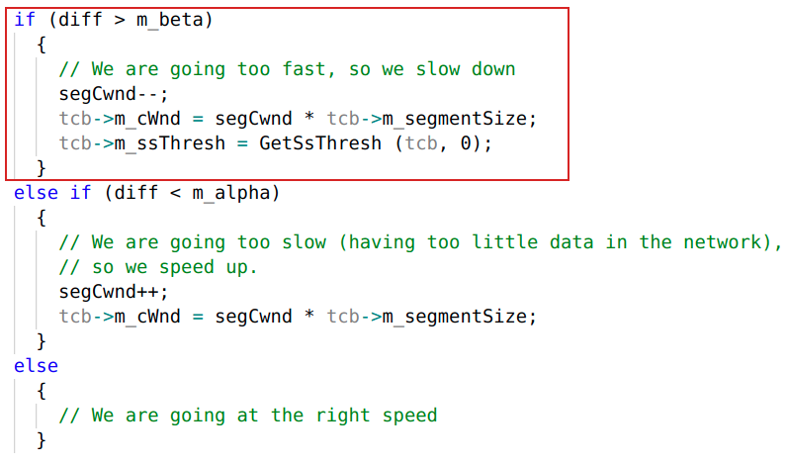
Congestion Avoidance in TCP Vegas
Implemented in IncreaseWindow()
Increase/Decrease Mode
Linearly Decreases

Slide 36
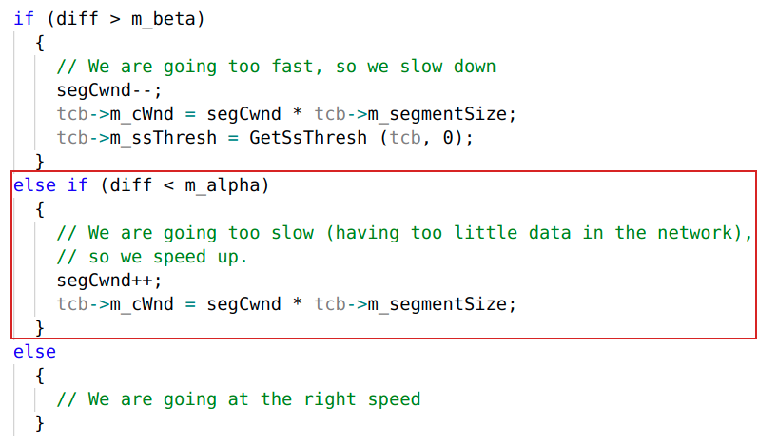
Congestion Avoidance in TCP Vegas
Implemented in IncreaseWindow()
Increase/Decrease Mode
Linearly Increases

Slide 37
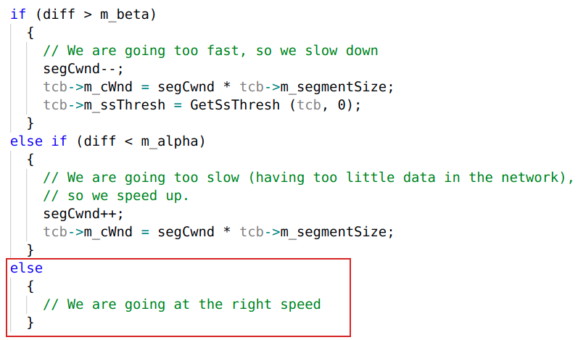
Congestion Avoidance in TCP Vegas
Implemented in IncreaseWindow()
Increase/Decrease Mode
Does Nothing

Slide 38
TCP NewReno Implementation

Slide 39
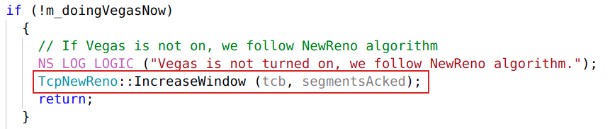
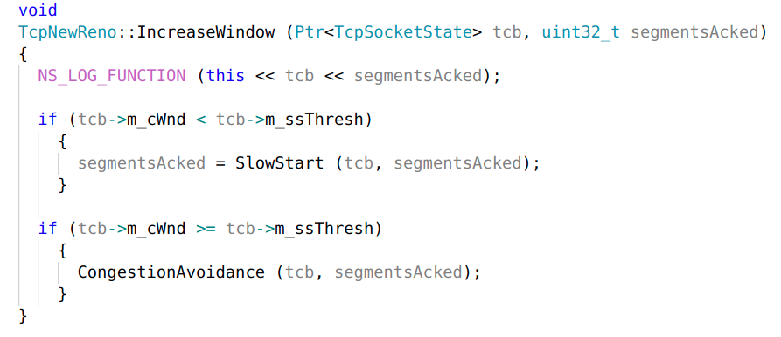
TcpNewReno :: IncreaseWindow
TCPVegas:IncreaseWindow()

Slide 40
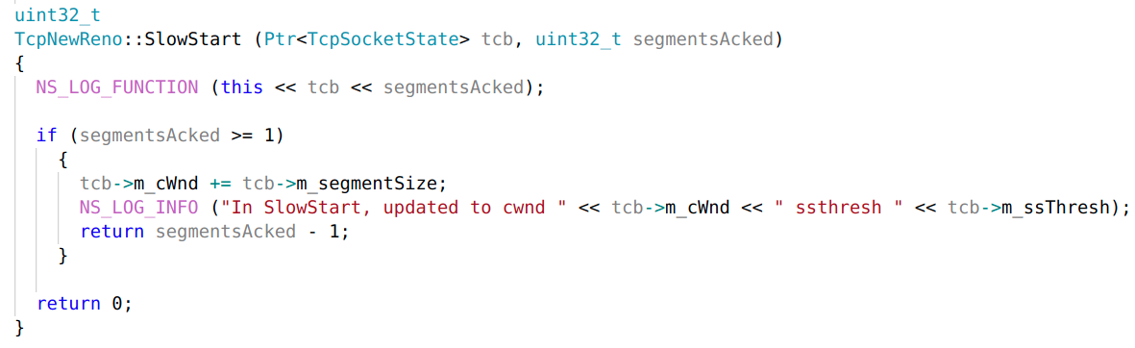
TcpNewReno :: SlowStart

Slide 41
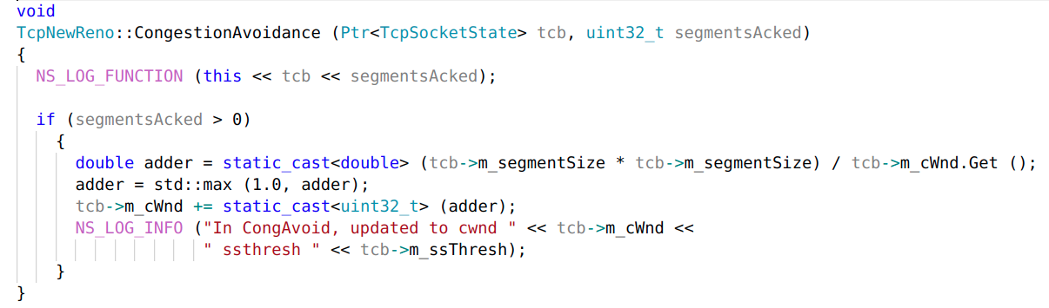
TcpNewReno :: CongestionAvoidance

Slide 42
Thank You

